Slide 1
Temporal Structure Normalization of Speech Feature for Robust Speech Recognition
Author :Xiong Xiao, Eng Siong Chng, Haizhou Li
Professor : 陳嘉平
Reporter : 楊治鏞

Slide 2
Outline
Introduction
Normalization of temporal structure
Experiment and results

Slide 3
Introduction
In this paper, we will examine the normalization strategy and investigate its effect on the ASR.
We design temporal filters to normalize the utterance-dependent feature PSD (i.e. the modulation spectrum) to a reference PSD function, which in effect is to normalize the feature’s temporal structure.

Slide 4






Temporal Structure Varies With Noise
We use the Mel-scaled filterbank cepstral coefficient (MFCC) as the feature for speech recognition.
Let be the cepstral coefficient of the frame and MFCC channel of an utterance.
we have time series, to , where is the number of channels.

Slide 5
Temporal Structure Varies With Noise
The time series of these raw features are first processed by CMN and CVN, referred to as mean and variance normalization (MVN) hereafter, then normalized by the proposed temporal structure normalization (see Fig. 1).

Slide 6
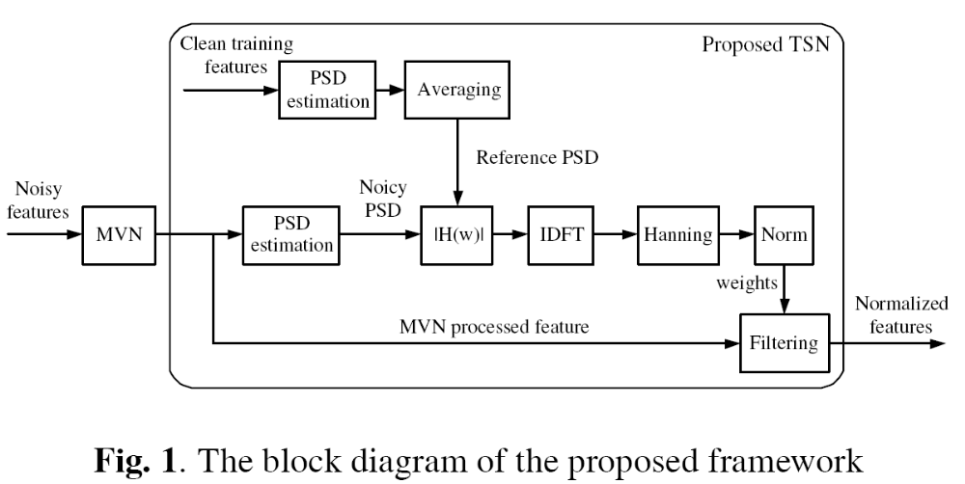

Slide 7

Temporal Structure Varies With Noise
We examine a speech utterance that is corrupted by additive car noise.
Fig. 2(a)–(c) shows the time series of the first MFCC feature after MVN processing for three SNR levels.
Fig. 2(d) illustrates their corresponding PSD functions.

Slide 8
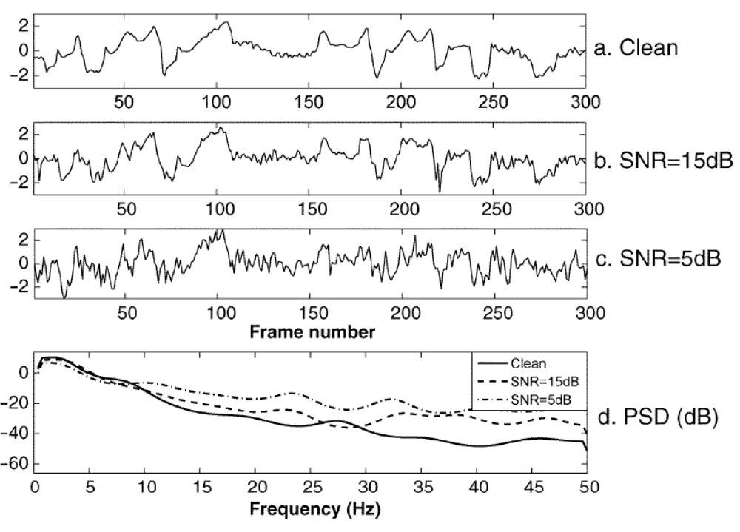

Slide 9




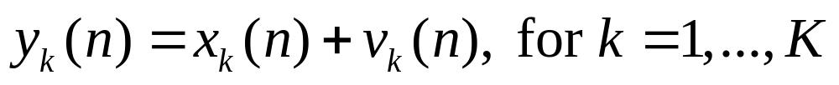
Normalizing the Temporal Structure Using the Square-root Wiener Filters
Let be the observed noisy speech feature series for the channel.
:clean
:noise

Slide 10
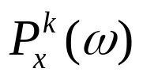
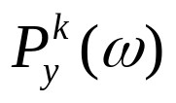


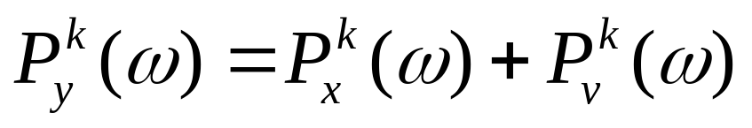
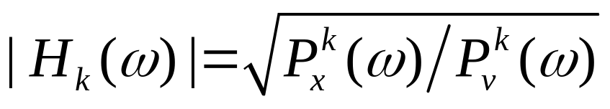
Normalizing the Temporal Structure Using the Square-root Wiener Filters
Let , and be the PSD of ,
and .
The magnitude response of the square-root Wiener filter is

Slide 11

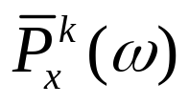

Training the reference PSD functions
As the PSD of the clean feature is unknown, we instead use an averaged PSD function to evaluate .
We call the reference PSD functions and obtain them by averaging the clean feature’s PSD over multiple utterances.

Slide 12
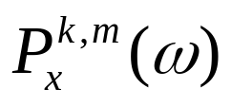



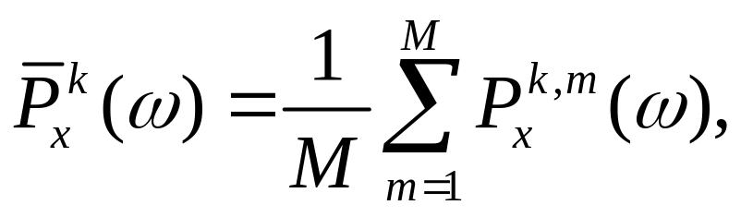
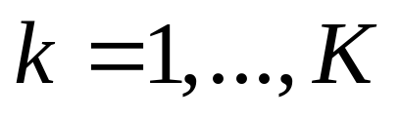
Training the reference PSD functions
Calculate the feature PSD of all channels of all training utterances , for and , where is the number of utterances used for training

Slide 13
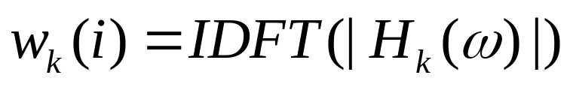
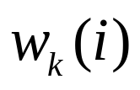
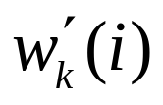

Normalizing Temporal Structure
Find the filter’s weights using the inverse discrete Fourier transform (IDFT).
Extract the central taps of to form .
Apply Hanning window on to reduce truncation effect.

Slide 14
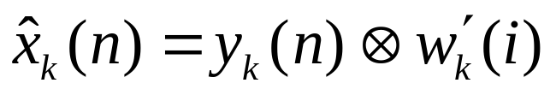
Normalizing Temporal Structure
Normalize the sum of the weights to one to ensure that the filter’s gain is unity at zero frequency.
The normalized features are estimated as

Slide 15
Experiment Settings
AURORA-2
The training features for TSN1’s reference functions are processed by MVN only.
Those for TSN2 are first processed by MVN and then smoothed by the ARMA filter used in MVA.

Slide 16
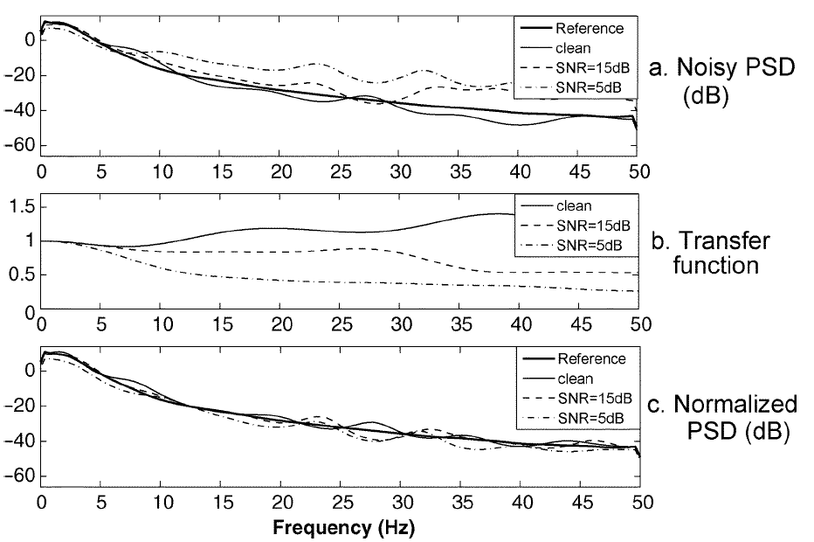
The normalization effects of TSN1

Slide 17
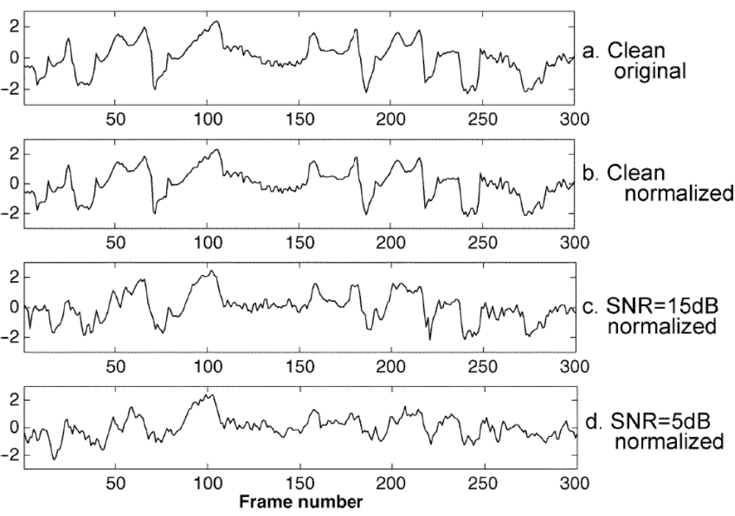

Slide 18
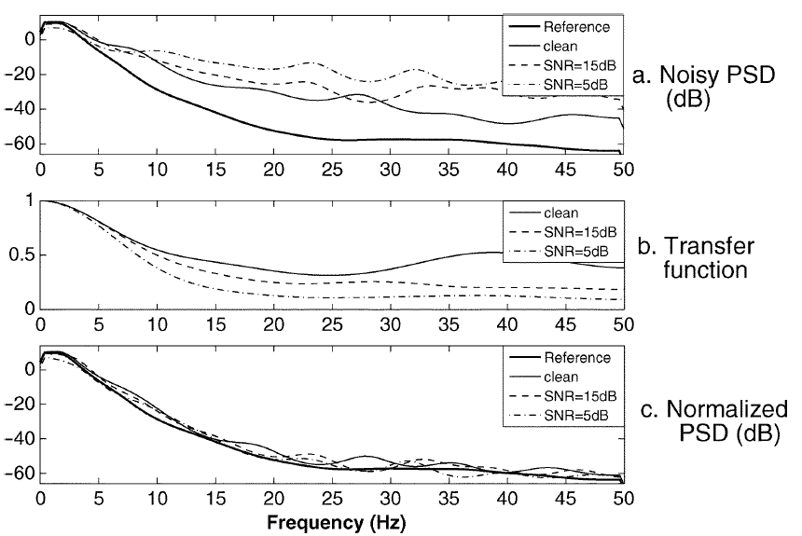
The normalization effects of TSN2

Slide 19
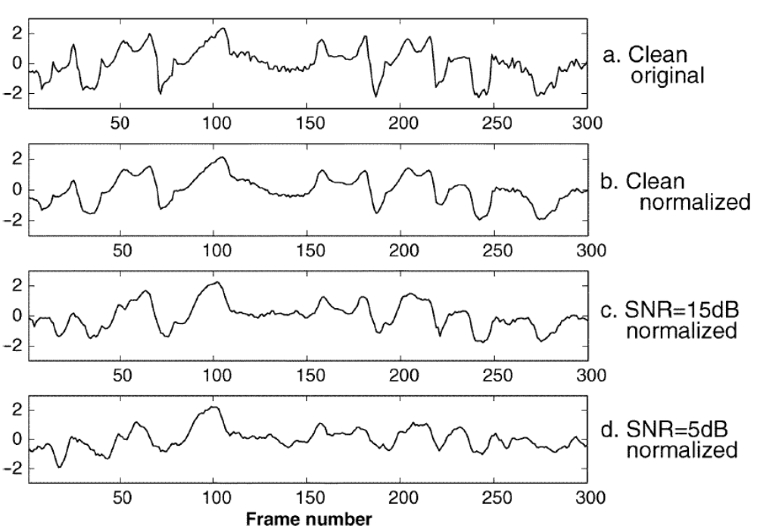

Slide 20
Recognition Results
we compare the performance of the proposed normalization schemes with 4 other methods using the AURORA-2 framework.
  a) MVN: CMN followed by CVN.
  b) RASTA: MVN followed by RASTA filtering.
  c) MVA (M=3): MVN followed by ARMA filtering.
  d) LPF: MVN followed by LPF filtering.
  e) TSN1: MVN followed by TSN1.
  f) TSN2: MVN followed by TSN2.

Slide 21
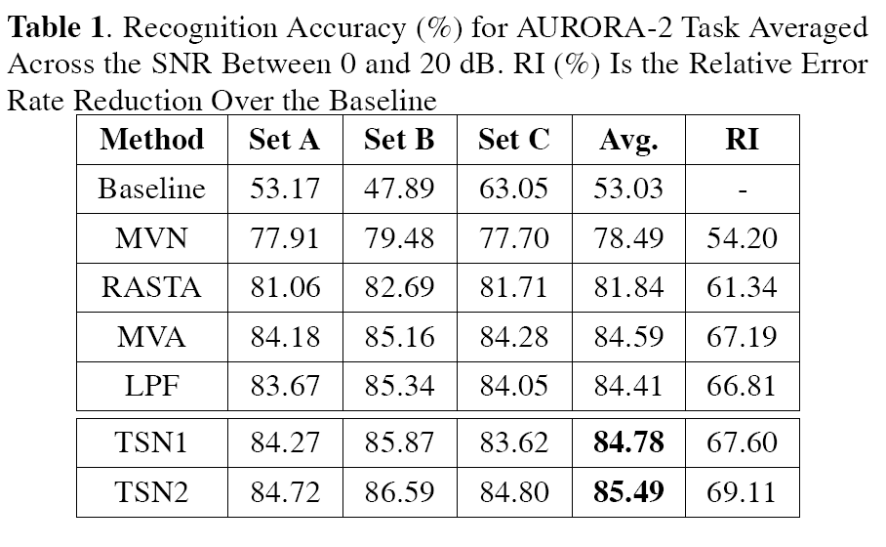

Slide 22
